Slide 1


Phishing Detection Extension Proof of Concept
CIS – 4951 Capstone II
Professor: Dr. Sadjadi
Ezekiel Garcia
Jonathan Iglesias
Giovani Labrador
Tristin Liebenberg
Eyaan Syed

Slide 2


DESCRIPTION | CHARACTERISTICS
Phishing : | Urgent Language
Spear Phishing | Generic Greetings
Whaling | Suspicious Links

Slide 3

Goals and Objectives
of the Extension
Real Time Protection
Detecting Harmful URLs
Suspicious Content Alerts

Slide 4

Scope and Limitations
Coverage of Phishing Techniques
Limitations in Detection
Need for Realistic Expectations

Slide 5

Key Functionalities and Features
URL Analysis
Content Scanning
User Alert Notifications

Slide 6

Component Overview
Key Components
Functional Roles
Integration Process

Slide 7
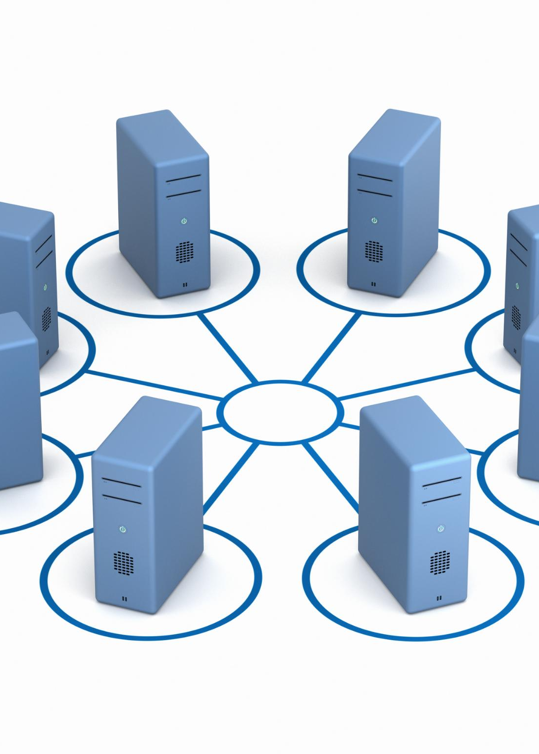
Overall System Architecture
User Interface
Data Storage
Backend Processing

Slide 8
Setting up the Development Environment
Key Java Libraries and Tools
IDE Selection
Java SDK Installation
Dependency Management
Java Libraries Overview
URL Analysis Libraries
Content Scanning Mechanisms
Alerting Mechanisms

Slide 9

Suspicious Content Detection
Importance of Detection
Analyzing Text and Links
Image Analysis

Slide 10

User Alerts and Notifications
Importance of Alerts
Timely Warnings
User Recommendations

